Slide 1
Class 2
The State of Play in International Trade and Trade Policy II:
Other by
Alan V. Deardorff
University of Michigan
2021
PubPol/Econ 541

Slide 2
Announcements
Note that if I don’t get through all of my slides, you should view them later. (But not the Aug 31 class.)
Office hours:
  Feel free to enter even if others are there
  If you want a private meeting, email me to schedule
Quiz 1 due Friday midnight.
  Accepted until Saturday midnight with penalty
  Covers material from last Thursday and today only.

Slide 3
Pause for News

Slide 4
State of Play: Other
Outline
  Background from KOM
  Brexit
  Pandemic and Trade
  Other Disputes and Actions

Slide 5
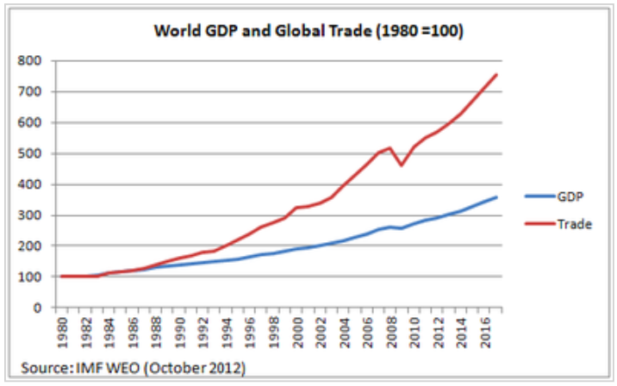
World Trade Growth
Notes:
https://g2reports.weebly.com/reports.html

Slide 6
Pause for Discussion

Slide 7
  Questions from KOM
How much has trade grown? why?
Who gains from trade?
What does trade between two countries depend on?
Why is the gravity model useful?
Do national borders interfere with trade?
Why is trade in services growing?

Slide 8
Brexit
Brexit Timeline
  Jun 23, 2016: Referendum
    UK votes to leave EU
  Mar 29, 2017: EU exit provision triggered
    UK PM initiates 2-year exit process
  2019: Several extensions asked and given
  Jan 31, 2020: UK leaves EU
    Transition period (policies unchanged) thru 2020
  Dec 31, 2020: Transition period ends
Notes:
Walker, Nigel, ” Brexit timeline: events leading to the UK’s exit from the European Union,” House of Commons Library, June 10, 2020.
https://commonslibrary.parliament.uk/research-briefings/cbp-7960/

Slide 9
Brexit
The Brexit Agreement
  Reached Dec 24, 2020
    EU Ambassadors approved Dec 28
    UK MPs approved Dec 30
    Signed Dec 30
    Effective provisionally Jan 1, 2021
    Entered into force May 1, 2021, after ratification
  Title: “Trade and Cooperation Agreement”

Slide 10
Brexit
The Brexit Agreement
  Features:
    Free Trade Agreement for goods, with rules of origin (no longer customs union)
    Some limited mutual market access for services
  Not included:
    Free movement of persons
    UK subject to European Court of Justice
    UK subject to EU regulations

Slide 11
Brexit
Northern Ireland (N.I.) Protocol
  Part of the Brexit Withdrawal Agreement from January 24, 2020
  Avoids hard border between N.I. (part of UK) and Ireland (EU member country) by
    Keeping N.I. in EU customs union
    Adding customs checks, etc., between N.I. and Great Britain (the rest of UK: England, Scotland, Wales)
  Reason: To avoid re-igniting the “Troubles”

Slide 12
Pause for Discussion

Slide 13
  Questions on Brexit (Kirkegaard)
What UK objectives are mentioned here as having been achieved by the agreement?
What aspects of UK-EU interactions will be adversely affected by the agreement?
What is the relevance of
  “rules of origin”?
  “minimal processing requirements”?

Slide 14
  Questions on Brexit
  (Castle)
What is the most problematic piece of the protocol?
Why did they not just have a normal EU-UK border between Ireland and Northern Ireland?
Why are sausages an issue?

Slide 15
Pandemic and Trade
Cases and deaths
Changes in trade
Changes in trade policies
Notes:
Walker, Nigel, ” Brexit timeline: events leading to the UK’s exit from the European Union,” House of Commons Library, June 10, 2020.
https://commonslibrary.parliament.uk/research-briefings/cbp-7960/

Slide 16
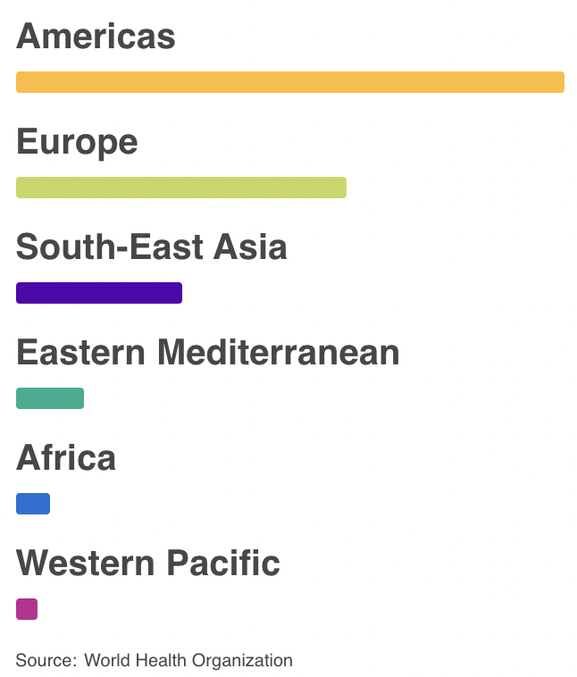
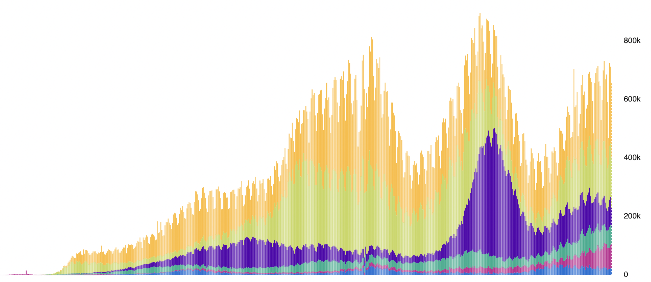
Cases
Daily Confirmed Cases
Apr. Jul. Oct. Jan. Apr. Jul.
Source: WHO Coronavirus Disease (COVID-19) Dashboard as of Aug 29, 2021
Notes:
WHO Coronavirus Disease (COVIC-19) Dashboard
https://covid19.who.int/?gclid=CjwKCAiAuoqABhAsEiwAdSkVVNd67qw_hEb4v9v3UxACJd_csZMJl8Yc5UjaAIYt53KJWSQiXZPlRxoCm0kQAvD_BwE

Slide 17
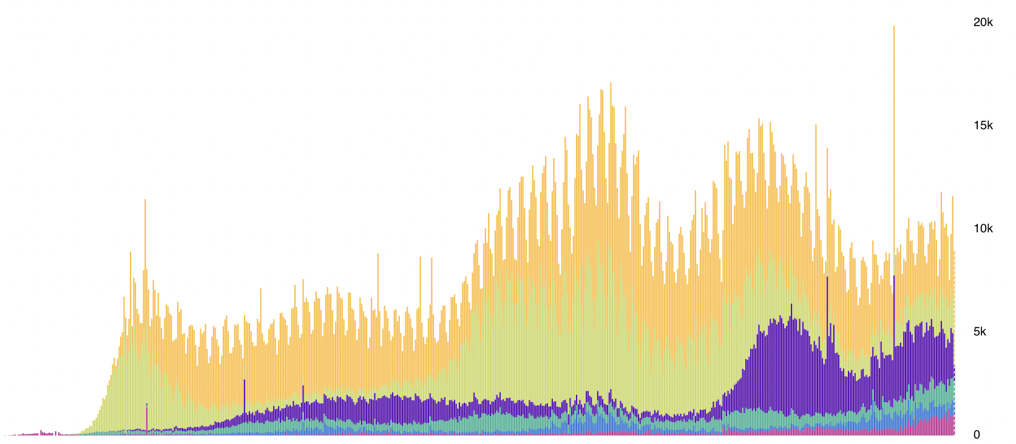
Deaths
Daily Deaths
Apr. Jul. Oct. Jan. Apr. Jul.
Source: WHO Coronavirus Disease (COVID-19) Dashboard as of Aug 29, 2021
Notes:
WHO Coronavirus Disease (COVIC-19) Dashboard
https://covid19.who.int/?gclid=CjwKCAiAuoqABhAsEiwAdSkVVNd67qw_hEb4v9v3UxACJd_csZMJl8Yc5UjaAIYt53KJWSQiXZPlRxoCm0kQAvD_BwE

Slide 18
Pandemic and Trade
Drop in trade, due to
  Factory shutdowns, first in China, then elsewhere, cutting supply
  Supply chains interrupted, cutting supply even from factories not shut down
  Incomes fell as jobs were lost, cutting demand
  Some shipping, and most air transport, stopped due to virus (much normally rides with passengers)
Notes:
Walker, Nigel, ” Brexit timeline: events leading to the UK’s exit from the European Union,” House of Commons Library, June 10, 2020.
https://commonslibrary.parliament.uk/research-briefings/cbp-7960/

Slide 19
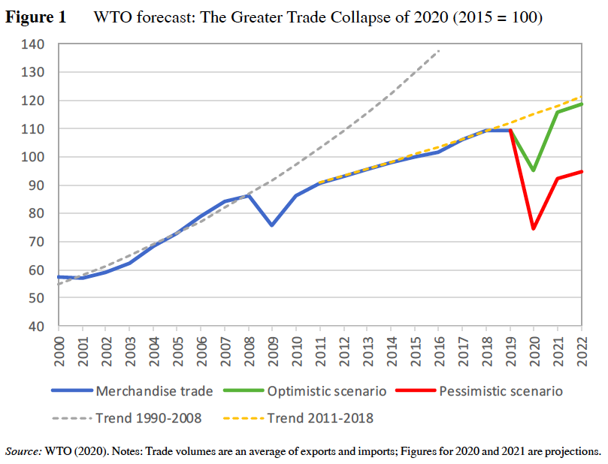
Notes:
Baldwin, Richard and Simon J. Evenett, “Introduction,” in Richard E. Baldwin and Simon J. Evenett, eds., COVID-19 and Trade Policy: Why Turning Inward Won’t Work, CEPR Press, 2020.

Slide 20
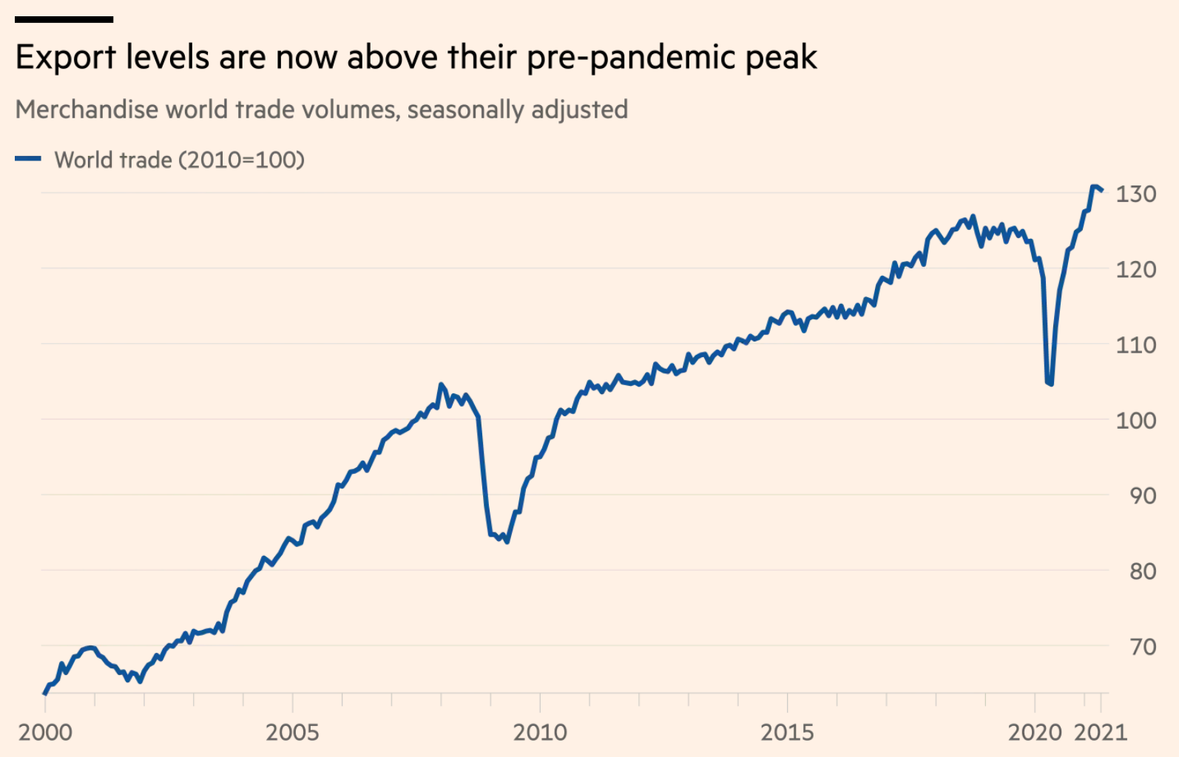
Pandemic
World Recession
Source: FT 8/25/21
Notes:
Jones, “Supply chains are a mess. So how come trade is booming?” Financial Times, August 25, 2021
https://www.ft.com/content/10f66c95-420c-4d2f-b04f-d6c8ab5af91f

Slide 21
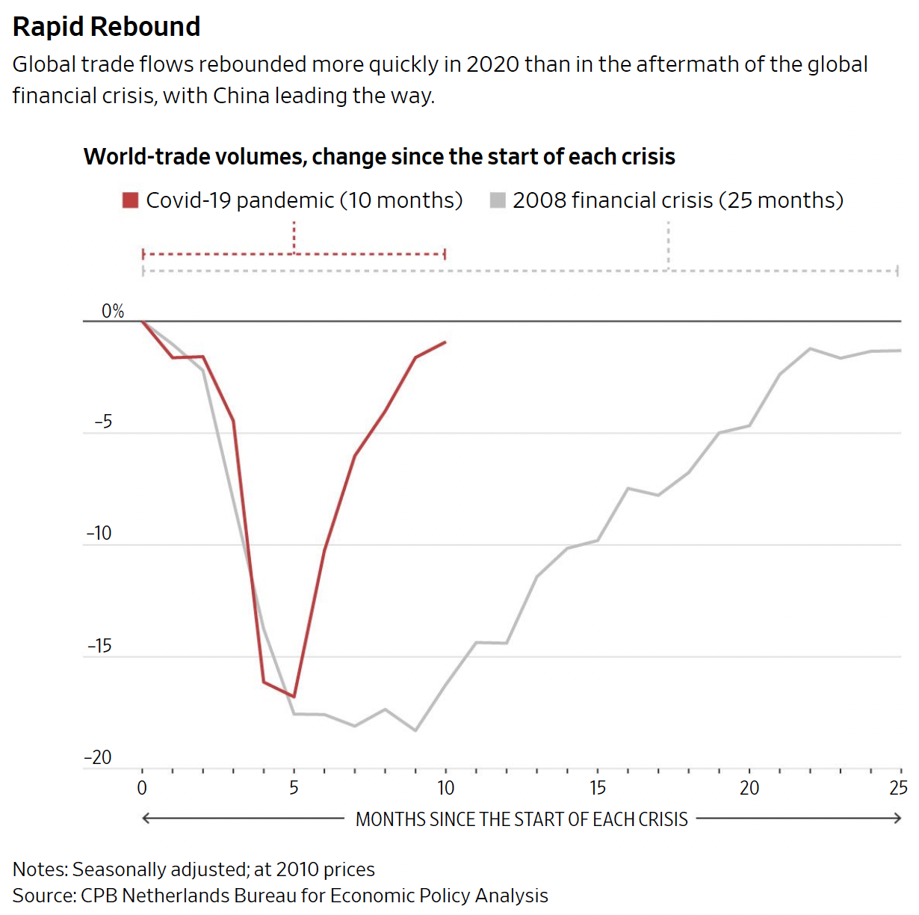
Hannon, WSJ, 2/25/21.
Notes:
Hannon, Paul, "Global Trade Roars Back From Depths of Covid-19 Pandemic", Wall Street Journal,, February 25, 2021.

Slide 22
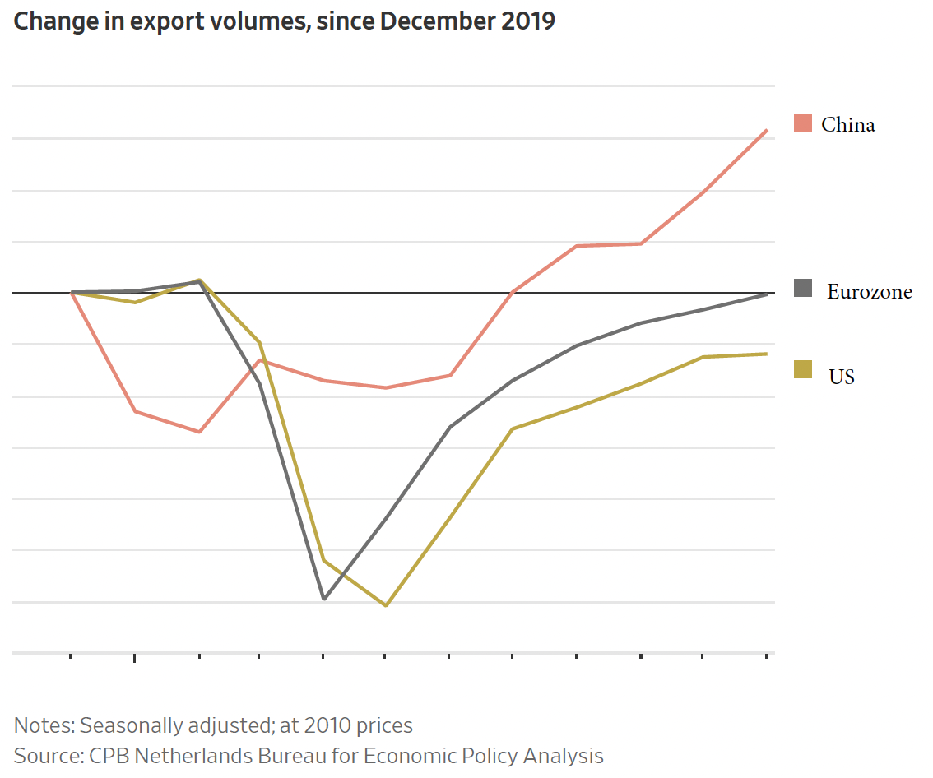
Hannon, WSJ, 2/25/21.
Notes:
Hannon, Paul, "Global Trade Roars Back From Depths of Covid-19 Pandemic", Wall Street Journal,, February 25, 2021.

Slide 23
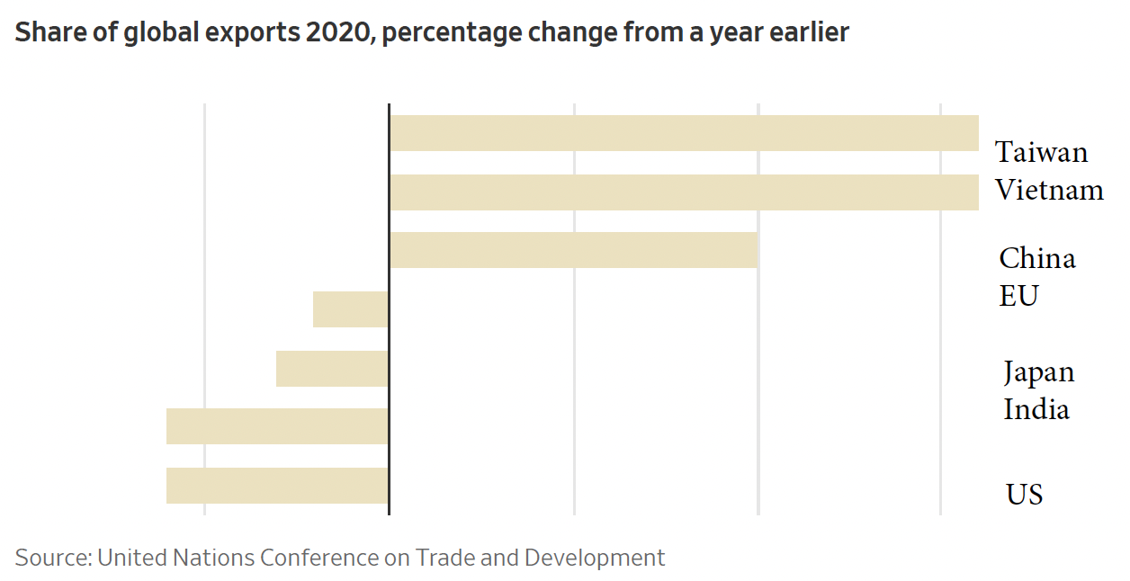
Hannon, WSJ, 2/25/21.
Notes:
Hannon, Paul, "Global Trade Roars Back From Depths of Covid-19 Pandemic", Wall Street Journal,, February 25, 2021.

Slide 24
Pandemic and Trade
Effects on policies
  Export bans to keep in tools to fight virus
  Import bans to keep out virus
  Tariff reductions (just a few, to help needed access, mostly on medical supplies)
  A group of countries committed to “keeping supply and trade links open” for “essential goods, especially medical supplies”
Notes:
Walker, Nigel, ” Brexit timeline: events leading to the UK’s exit from the European Union,” House of Commons Library, June 10, 2020.
https://commonslibrary.parliament.uk/research-briefings/cbp-7960/

Slide 25
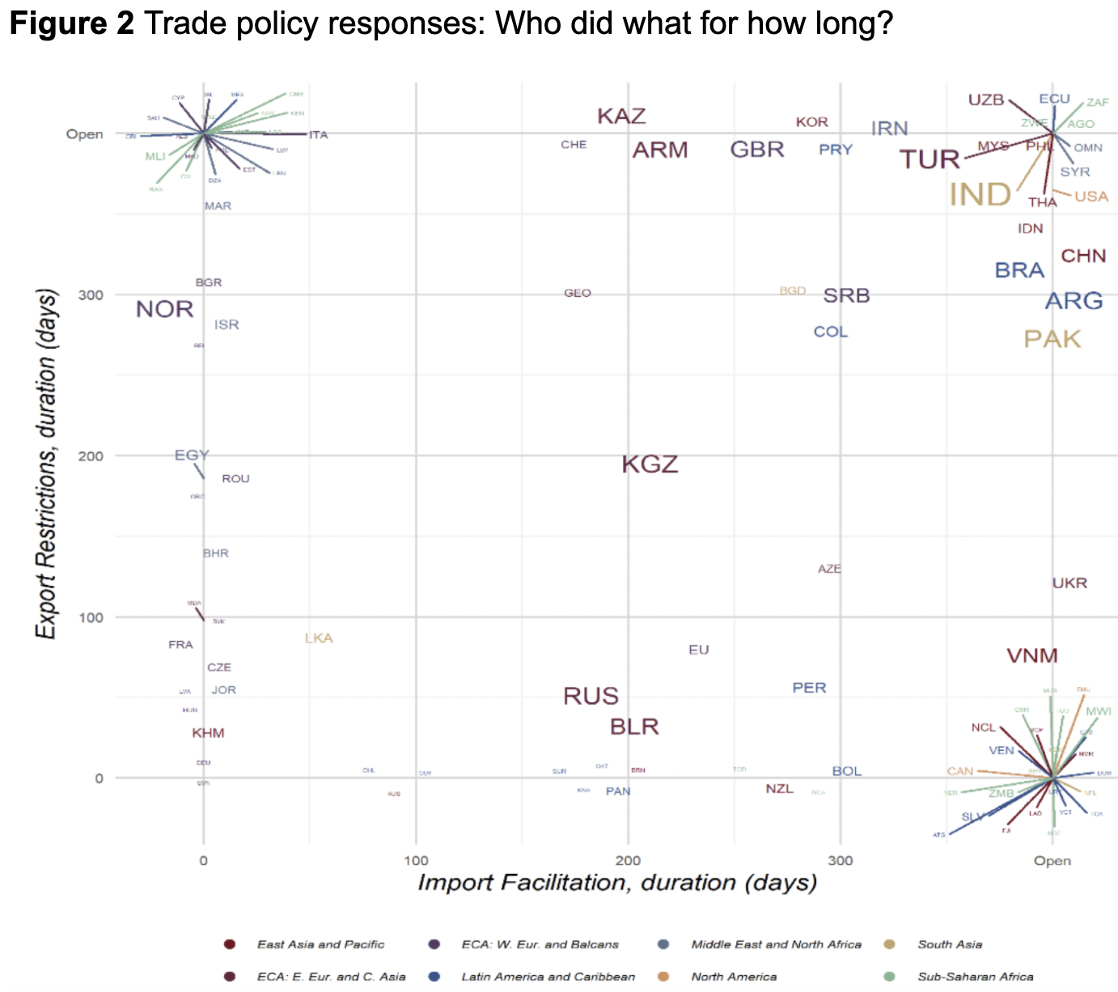
Countries with only export restriction, extending beyond 2020
USA
Inc. ITL
Inc. IND
Notes: Coloured lines point to the names of countries located in the same space of a graph. Countries are displayed in terms of the duration (in days) of the longest period with at least one active import liberalization measure (horizontal axis) and at least one active export restriction (vertical axis). The value "Open" at the end of each axis identifies measures without an end date or that extend beyond December 2020. The font size of each country code is proportional to the total number of measures implemented; colours identify the associated world region.
Countries with both import facilitation and export restriction, extending beyond 2020
CHN
Inc. CAN
Countries with only import facilitation, extending beyond 2020
Source: Evenett et al.
Notes:
Evenett, Simon, Matteo Fiorini, Johannes Fritz, Bernard Hoekman, Piotr Lukaszuk, Nadia Rocha,Michele Ruta, Filippo Santi, Anirudh Shingal, “Trade policy responses to the COVID-19 pandemic: Evidence from a new dataset,” VOXEU, December 11, 2020.
https://voxeu.org/article/trade-policy-responses-covid-19-pandemic-new-dataset

Slide 26
Pandemic and Trade
Other effects
  Seamen stranded on board
  Countries race to be first with vaccine
  Increased desire for self-sufficiency
  Concern about reliance on China for PPE
  Trade in education suffers
  Price of oil became negative
  Countries with vaccines restrict exports
Notes:
Walker, Nigel, ” Brexit timeline: events leading to the UK’s exit from the European Union,” House of Commons Library, June 10, 2020.
https://commonslibrary.parliament.uk/research-briefings/cbp-7960/

Slide 27
Pause for Discussion

Slide 28
  Questions on Pandemic (Hannon)
How does the response of world trade to the pandemic compare to what happened due to the world financial crisis of 2008?
Did trade recover the same in different parts of the world?
Why has some shipping been difficult?

Slide 29
  Questions on Pandemic (Kuchler )
What is COVAX? Is it reaching its goal?
What problem does this new “market place” attempt to solve?
Are trade barriers an issue for vaccines, and if so, by whom?
Why are rich countries continuing to order more shots than needed to vaccinate everyone?

Slide 30
Other Disputes and Actions
Disputes
  Buy American
  Digital tax
  Airbus-Boeing
  Softwood lumber
  Australia-China
  China-EU investment
Notes:
Walker, Nigel, ” Brexit timeline: events leading to the UK’s exit from the European Union,” House of Commons Library, June 10, 2020.
https://commonslibrary.parliament.uk/research-briefings/cbp-7960/

Slide 31
Pause for Discussion

Slide 32
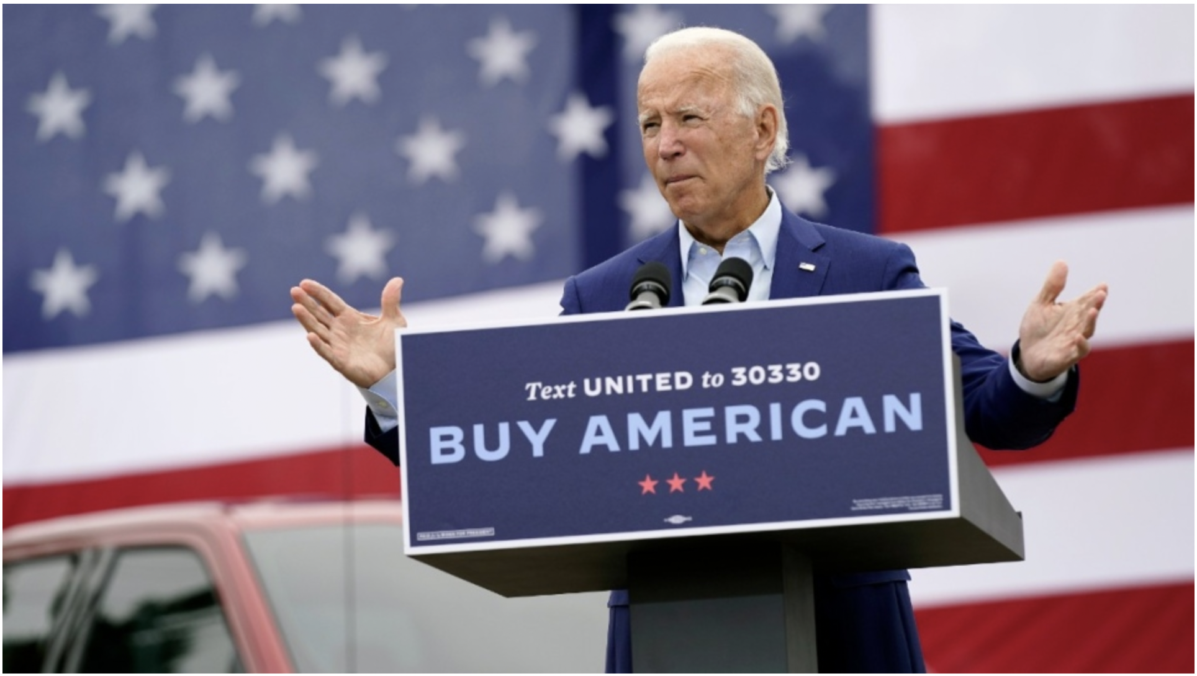
Buy American
Notes:
https://bullandbearmcgill.com/bidens-buy-american-road-to-recovery-or-old-mistake/
Julian Robinson, “BIDEN’S “BUY AMERICAN” – ROAD TO RECOVERY OR OLD MISTAKE?”, The Bull & Bear, Feb 15, 2021

Slide 33
  Questions on Other:
  Buy American (Biden)
What, according to this, should be the objective of federal procurement?
Who is responsible for overseeing this process?
Are agencies permitted to not buy American?

Slide 34
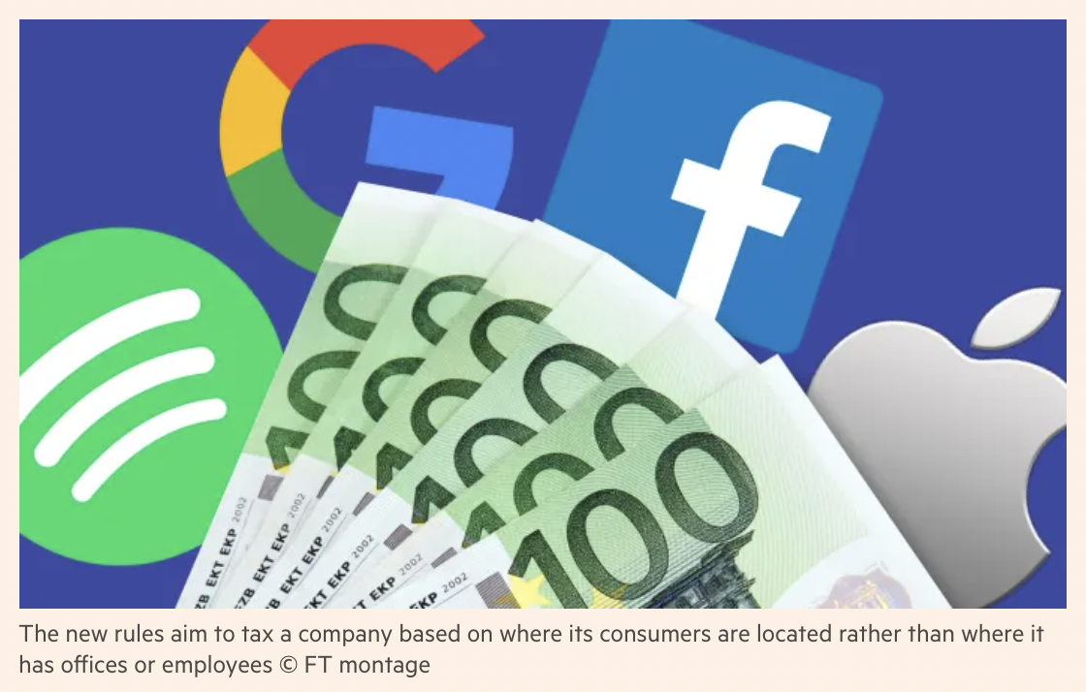
Digital Tax
Notes:
https://www.ft.com/content/1cbff630-2d09-11e8-9b4b-bc4b9f08f381
Mehreen Khan and Rochelle Toplensky, “The EU’s ‘digital tax’: how US tech groups would be hit,’ Financial Times, Mar 21, 2018.

Slide 35
  Questions on Other:
  Digital Tax (H&H)
Why are countries taxing digital services?
What is the US saying it will do, and to whom?
Does this policy originate with the Biden administration?

Slide 36
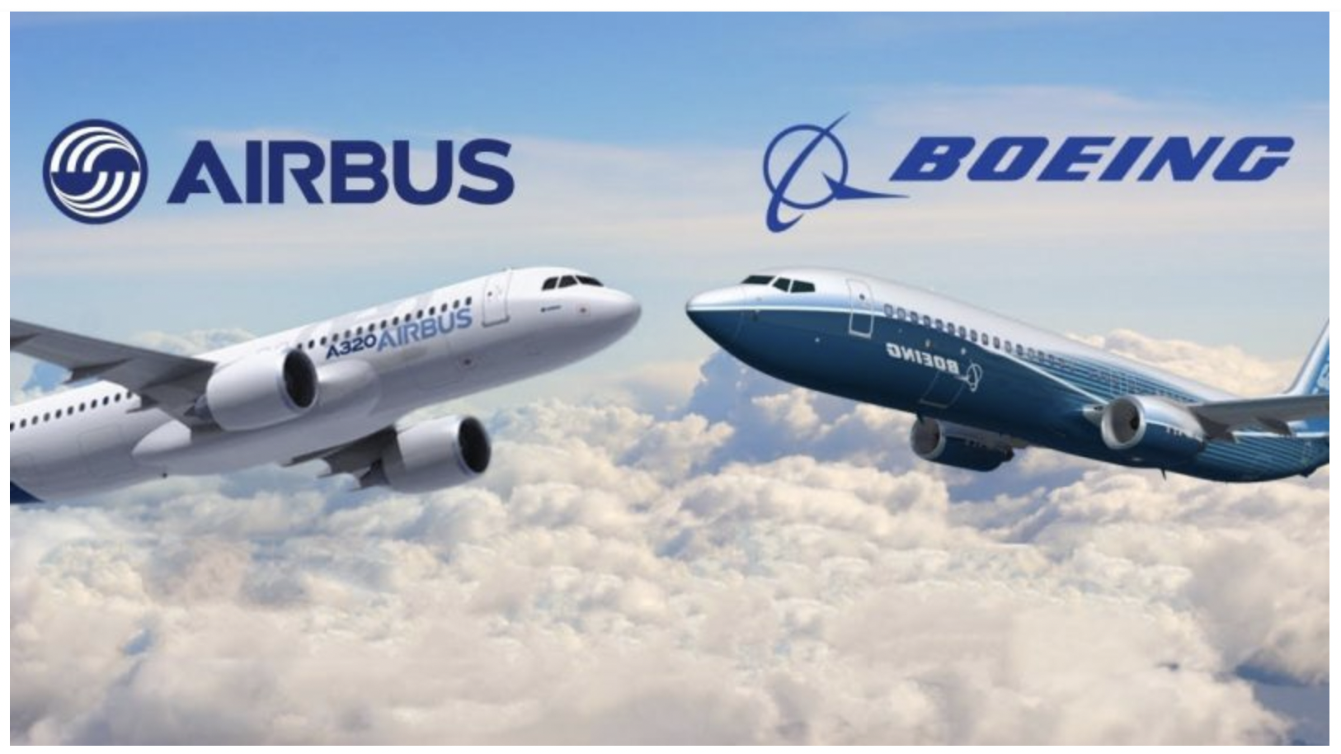
Airbus-Boeing
Notes:
https://www.wingsoverquebec.com/?p=9081

Slide 37
  Questions on Other:
  Airbus-Boeing (Michaels et al.)
Are the tariffs only now being suspended? And for how long will they be suspended?
When did the dispute start, and when were the tariffs first levied?
What will the US and EU try to achieve during this 5-year suspension, and why?
How, if at all, has the WTO been involved?
On what products did the US and EU place tariffs?

Slide 38
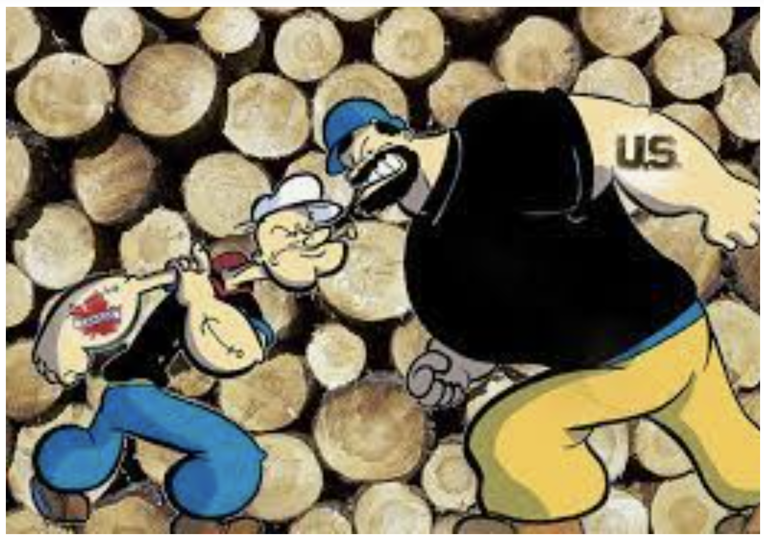
Softwood Lumber
Notes:
https://www.e-know.ca/regions/east-kootenay/softwood-lumber-dispute-avoided/

Slide 39
  Questions on Other:
  Softwood Lumber (Kaplan)
What is the core issue in this dispute?
When did the dispute start? Has it been just a single ongoing dispute?
Who levied the tariffs and how high have they been?
Why is there pressure in the US to remove the tariffs?
Who wants to keep the tariffs and why?

Slide 40
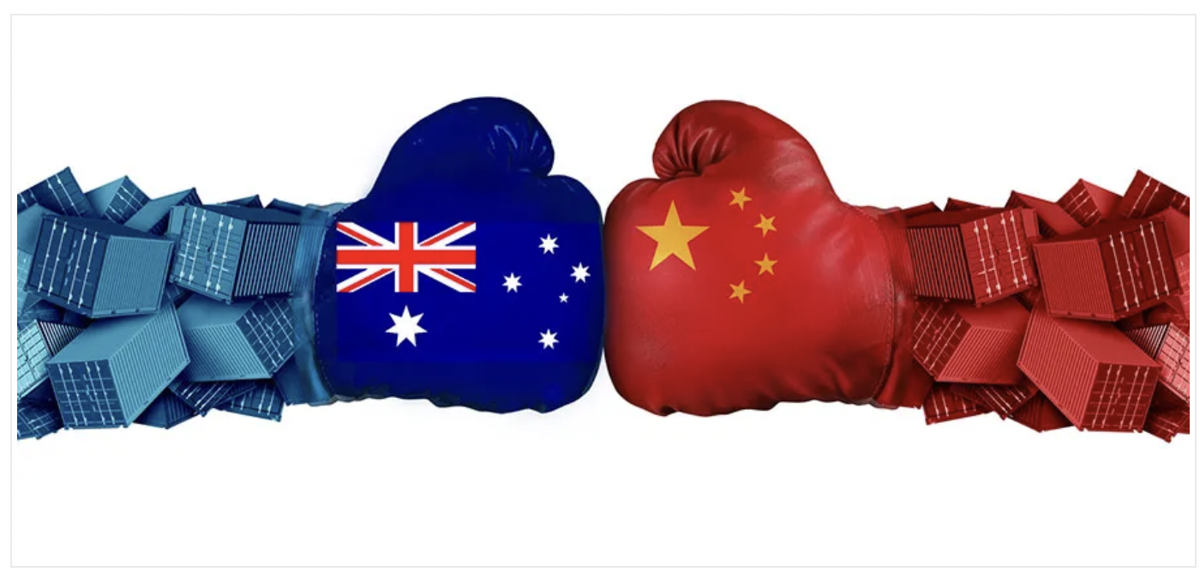
Australia-China
Notes:
https://www.silkroadbriefing.com/news/2021/05/06/decoupling-from-china-part-three-after-the-united-states-and-eu-now-its-australias-turn/
Decoupling From China Part Three: After the United States and EU, Now Its Australia’s Turn, Silk Road Briefing

Slide 41
  Questions on Other:
  Australia-China (Smyth)
What prompted the dispute between Australia and China?
What has China done to Australia?
Has Australia retaliated with trade restrictions against China?
How have Australian exporters and Chinese importers adapted?
If trade has not fallen, has any harm been done?

Slide 42
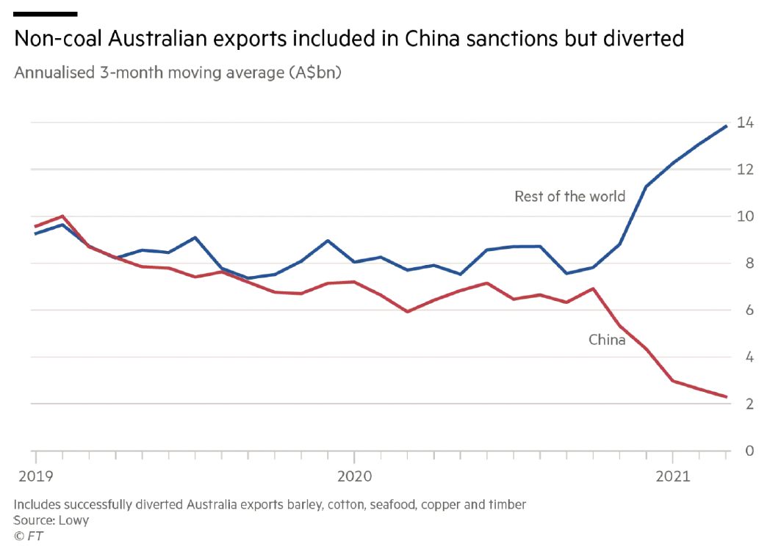
Smyth, FT, 5/25/21.
Notes:
Smyth, Jamie, "Australia shrugs off China trade dispute and opens new markets", Financial Time, May 25, 2021.
https://www.ft.com/content/95ad03ce-f012-49e9-a0c2-6e9e95353dd1

Slide 43
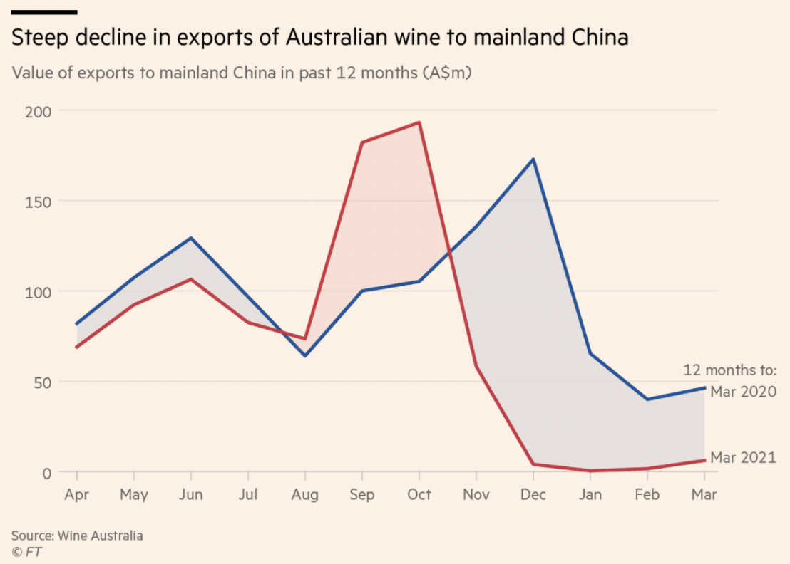
Smyth, FT, 5/25/21.
Notes:
Smyth, Jamie, "Australia shrugs off China trade dispute and opens new markets", Financial Time, May 25, 2021.
https://www.ft.com/content/95ad03ce-f012-49e9-a0c2-6e9e95353dd1

Slide 44
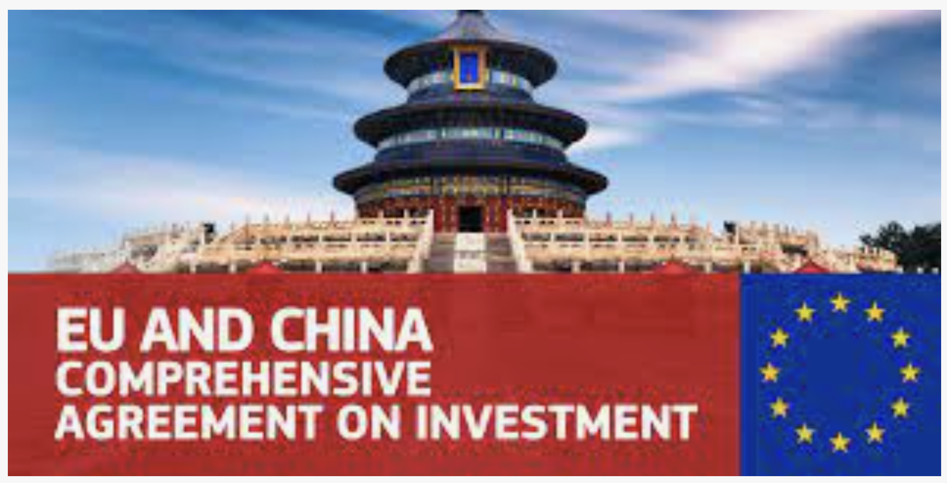
China-EU Investment Agreement
Notes:
https://ec.europa.eu/trade/policy/in-focus/eu-china-agreement/

Slide 45
  Questions on Other:
  China-EU Investment (E&M)
What does the agreement do?
Why is this more a victory for China than for the EU?
What is the only constituency in the EU that is mentioned here as supporting the agreement?
How long did these negotiations take, and what prompted them to finish when they did?

